Slide 1



Tree Species Classification
Name: Mridul Singh Rajput

Slide 2

Learning Objectives
To develop an AI-powered application for tree species identification
and recommendation.
To integrate diverse machine learning models (Nearest Neighbors
and Convolutional Neural Networks) into a unified platform.
To create a user-friendly web interface using Streamlit for
accessibility.
To implement robust data and model loading mechanisms with error
handling.
To provide insights into tree distribution and suitability based on
geographical and physical attributes.
GOAL
Source :
www.freepik.com/

Slide 3
Tools and Technology used
Python: Core programming language.
Streamlit: For building interactive web applications.
Pandas: For data manipulation and analysis.
NumPy: For numerical operations, especially array handling.
Collections (Counter): For efficient counting of elements.
Joblib: For efficient loading of pre-trained Scikit-learn models (Scaler, Nearest Neighbors).
TensorFlow & Keras: For building, training, and loading the Convolutional Neural Network (CNN)
model for image classification.
PIL (Pillow): For image processing and manipulation.

Slide 4
Methodology
1. Data & Model Loading
Efficient Caching: Utilized Streamlit's @st.cache_data and @st.cache_resource decorators for fast, one-time loading of the
tree dataset (tree_data.pkl) and pre-trained models (scaler.joblib, nn_model.joblib, basic_cnn_tree_species.h5).
Robust Error Handling: Implemented try-except blocks to gracefully handle FileNotFoundError and other exceptions during
data and model loading, providing user-friendly error messages.
2. Tree Recommendation by Location (Nearest Neighbors)
Input Features: Takes user inputs for Latitude, Longitude, Diameter, Native Status, City, and State.
Categorical Encoding: Converts selected categorical features (Native Status, City, State) into numerical codes using the
categories learned from the dataset.
Feature Scaling: Applies a pre-trained StandardScaler to normalize numerical input features.
Similarity Search: Employs a pre-trained NearestNeighbors model to find the 5 most similar tree entries in the dataset based
on the scaled input features.
Species Aggregation: Counts the occurrences of common names among the nearest neighbors to recommend the top 5 most
frequently found species.

Slide 5
Methodology
3. Finding Locations for a Tree Species
Species Selection: Allows users to select a specific tree species from a dropdown list.
Data Filtering: Filters the main dataset to include only records for the selected species.
Location Aggregation: Groups the filtered data by 'city' and 'state' and counts the occurrences to identify the most
common locations.
Display: Presents the top 10 common locations in a clear DataFrame format.
4. Image-based Tree Identification (Convolutional Neural Network - CNN)
Image Upload: Enables users to upload tree images (JPG, JPEG, PNG).
Image Preprocessing: Resizes uploaded images to a standard 224x224 pixels and normalizes pixel values to [0, 1].
Model Prediction: Utilizes a pre-trained CNN model (basic_cnn_tree_species.h5) to predict the tree species from the
processed image.
Confidence & Top Predictions: Displays the predicted species with its confidence score and lists the top 3 alternative
predictions with their respective confidences.
Integrated Location Search: Automatically fetches and displays common locations for the identified tree species,
enhancing the utility of the image recognition feature.

Slide 6
Problem Statement:
Difficulty in Tree Identification: Non-experts often struggle to accurately identify tree species, which is
crucial for gardening, urban planning, and ecological studies.
Lack of Location-Specific Tree Guidance: It's challenging to determine which tree species are best suited
for a particular geographical location or to find where a specific species commonly grows.
Manual Data Analysis is Cumbersome: Manually sifting through large datasets to find tree distribution
patterns or recommendations is time-consuming and inefficient.
Environmental Factors Complexity: Understanding how local climate, soil, and other environmental factors
influence tree growth and suitability is complex for the average user.
Lack of Integrated Solutions: Existing tools for identification, suitability, and data often operate in silos,
preventing a holistic approach to tree management.
On-Site Identification Challenges: Identifying trees in the field can be difficult due to varying light conditions,
seasonal changes, and the sheer volume of species.

Slide 7
Solution:
The "Tree Species Classification" provides a multi-faceted solution:
"Recommend Trees by Location" Mode: Offers data-driven suggestions for tree species that are likely to thrive in a specified area, considering factors like latitude, longitude, diameter, native status, city, and state.
"Find Locations for a Tree" Mode: Quickly identifies and lists the most common cities and states where a chosen tree species is found, aiding in research or planning.
"Identify Tree from Image" Mode: Leverages advanced deep learning to instantly predict a tree's species from an uploaded image, providing confidence scores and then linking to its common locations.
This integrated approach makes complex tree-related information accessible and actionable for a wide range of users.

Slide 8
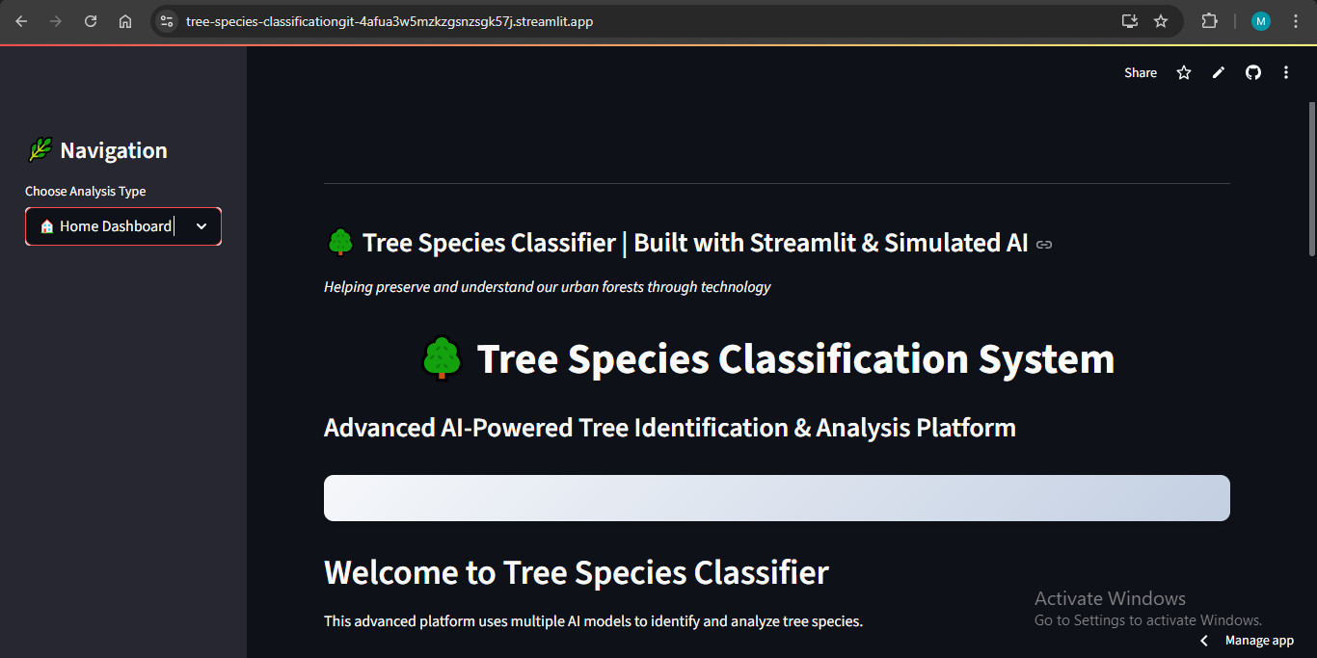
Screenshot of Output:

Slide 9
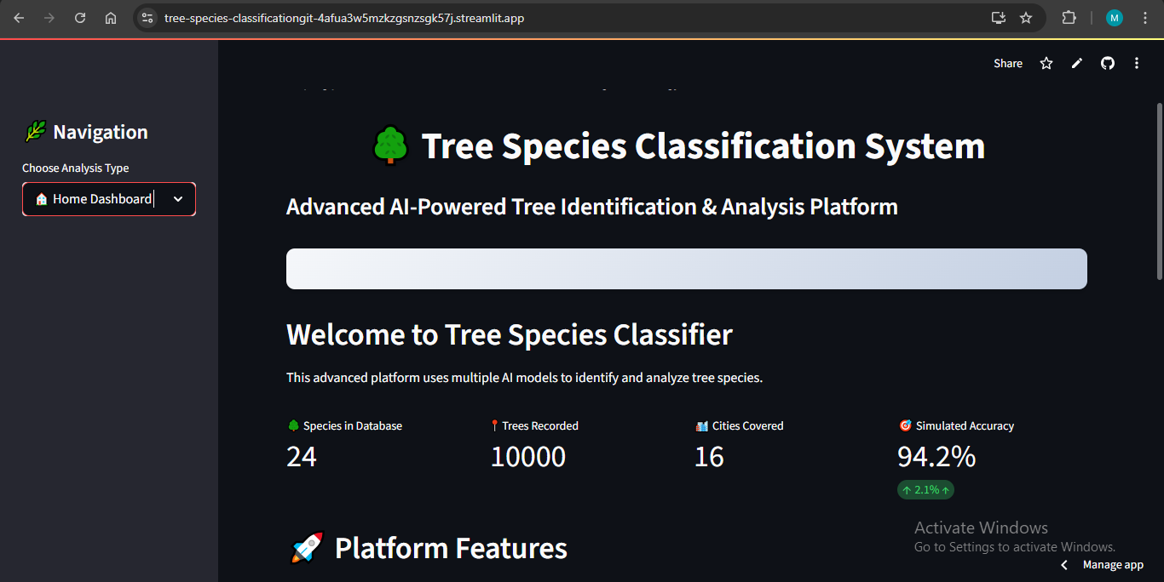
Screenshot of Output:

Slide 10
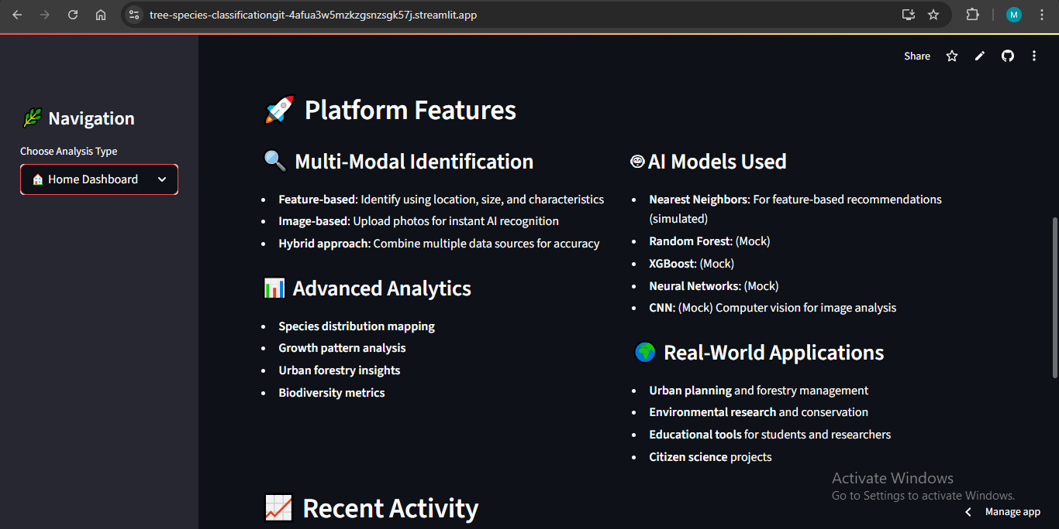
Screenshot of Output:

Slide 11
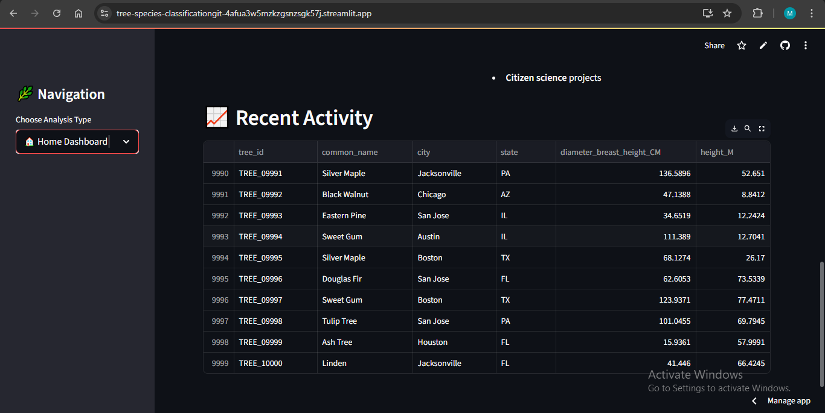
Screenshot of Output:

Slide 12
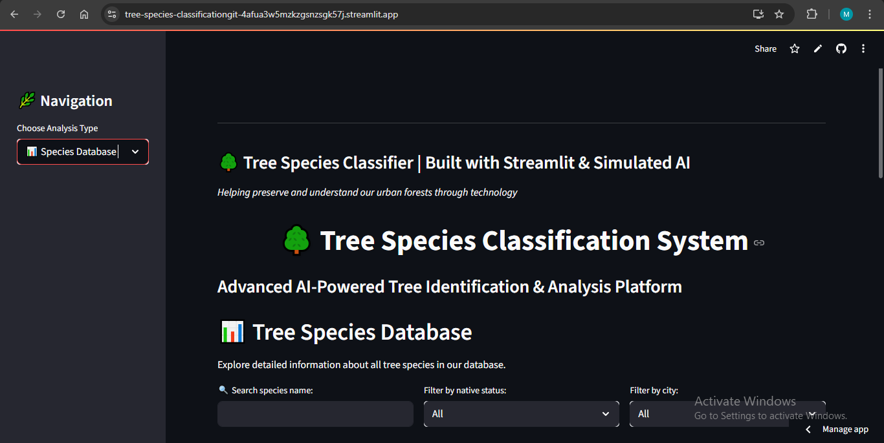
Screenshot of Output:

Slide 13
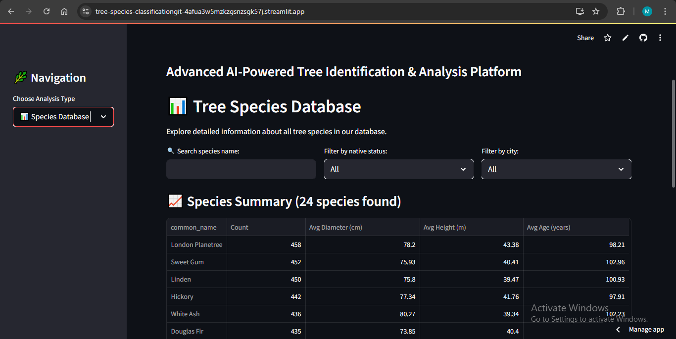
Screenshot of Output:

Slide 14
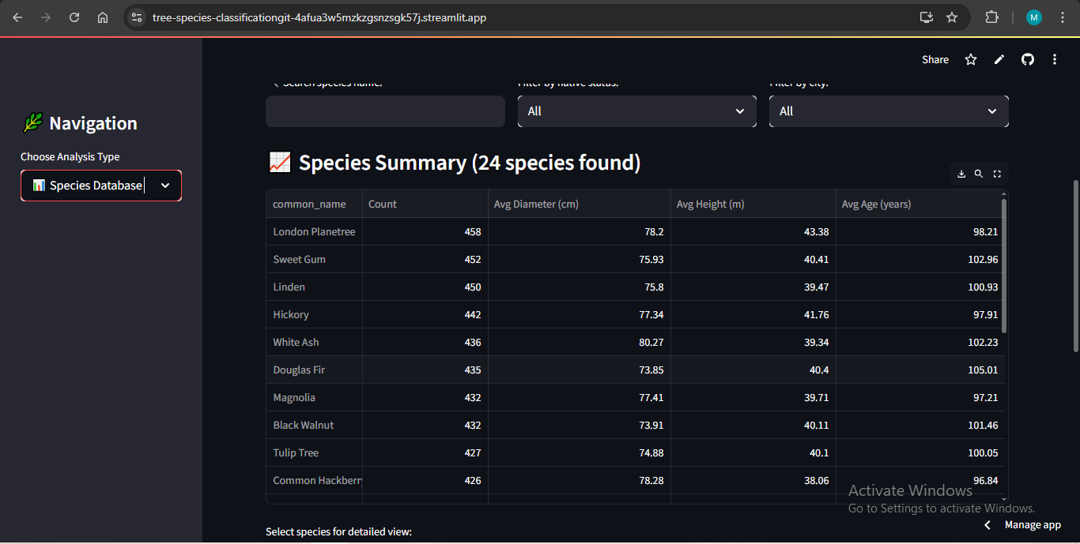
Screenshot of Output:

Slide 15
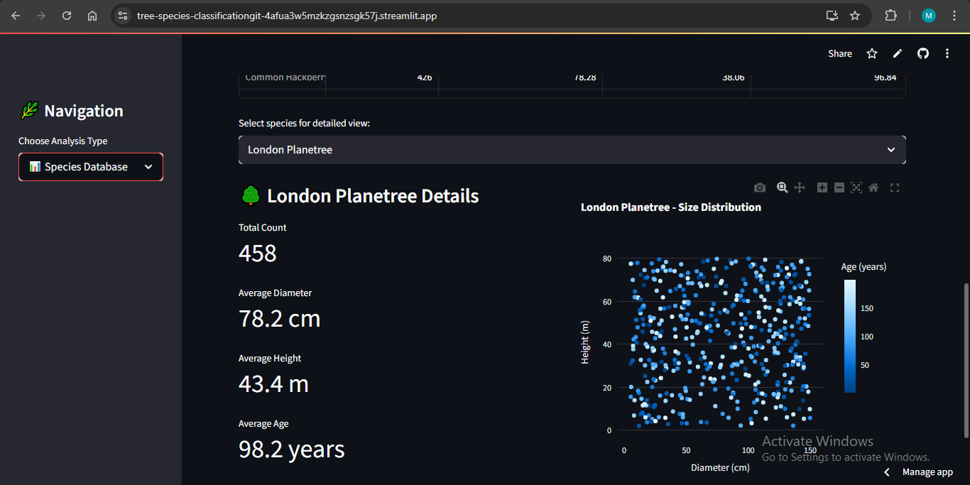
Screenshot of Output:

Slide 16
Conclusion:
The “Trees Species Classification" successfully demonstrates the power of machine learning (Nearest
Neighbors and CNNs) combined with a user-friendly interface (Streamlit) to solve real-world problems in
arboriculture and environmental management.
The application provides valuable insights for tree identification, location-based recommendations, and
understanding species distribution.
The robust error handling ensures a more stable and reliable user experience.
It serves as a practical tool for various stakeholders, from gardeners and urban planners to environmental researchers.
The project significantly reduces the manual effort and inefficiency traditionally associated with tree
data analysis and identification.
Its successful integration of advanced AI with an accessible interface paves the way for broader adoption
and future enhancements in ecological data management.

